Slide 1
Using the fx-83/85GT CW for statistics
Task A: Finding the mean from a frequency table
1) This frequency table shows the number of goals scored in each match by all the teams in a club over one football season.
Goals scored | Frequency
0 | 19
1 | 34
2 | 21
3 | 15
4 | 11
What was the mean number of goals scored?
2) This frequency table shows the star rating received by a restaurant over its opening weekend.
Star rating | Frequency
1 | 12
2 | 18
3 | 21
4 | 38
5 | 45
What was the mean star rating?
3) A class take a quiz, marked out of 6. The frequency table shows the results for the class.
Quiz score | 0 | 1 | 2 | 3 | 4 | 5 | 6
Frequency | 3 | 4 | 4 | 7 | 10 | 4 | 1
What is the mean number of marks per pupil?

Slide 2
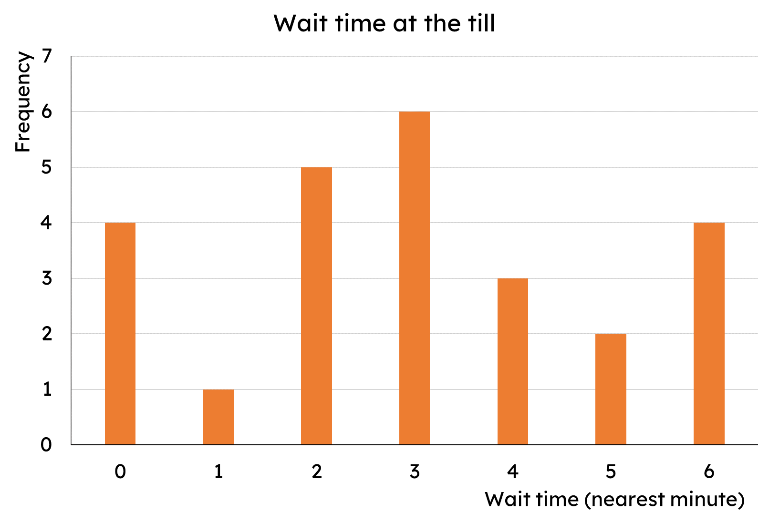
Using the fx-83/85GT CW for statistics
4) The frequency table shows the number of bedrooms in different houses within an area of a town.
Bedrooms | Frequency
1 | 20
2 | 93
3 | 54
4 | 33
What is the mean number of bedrooms?
5) The bar chart shows the length of time customers spent waiting at a self-service till (to the nearest minute).
What is the mean wait time?
Task B: Analysis
1) This frequency table shows the number of goals scored in each match by all the teams in a club over one football season.
Goals scored | Frequency
0 | 19
1 | 34
2 | 21
3 | 15
4 | 11
a) Calculate the median.
b) Calculate the interquartile range.
c) Would the club prefer to report the mean or median as the average number of goals scored? Why?

Slide 3
Using the fx-83/85GT CW for statistics
2) This frequency table shows the star rating received by a restaurant over its opening weekend.
Star rating | Frequency
1 | 12
2 | 18
3 | 21
4 | 38
5 | 45
a) Calculate the median.
b) Calculate the interquartile range.
c) Would the restaurant prefer to report the mean or median as the average rating? Why?
3) The frequency table shows the number of bedrooms in different houses within an area of a town.
Bedrooms | Frequency
1 | 20
2 | 93
3 | 54
4 | 33
A developer wishes to build more expensive houses (3+ bedrooms) but the local council want cheaper housing. The council argue that there are already enough houses with 3 or more bedrooms.
Are the council correct? Use the data to support your decision.
4) The bar chart shows the length of time customers spent waiting at a self-service till (to the nearest minute).
Management want every customer to be queuing for less than the average queue time.
a) Calculate the average queue time.
b) Explain why it is not possible for everyone to queue for less time than the average queue time.
Mathematics in Education and Industry
v2.5

